Slide 1
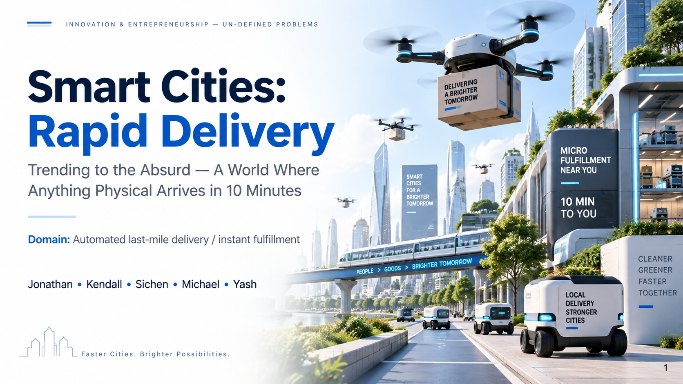
Notes:
Slide 1: Cover
What this slide is doing:
- Introduces the domain: automated last-mile delivery / instant fulfillment.
- Frames the project as a future-oriented exploration, not just a summary of today's delivery apps.
- Signals that the analysis method is "Trending to the Absurd" — we will push a real trend into an extreme future to discover new opportunity spaces.
Core idea to understand:
- The topic is not simply "how to deliver faster."
- The deeper question is what happens to cities, ownership, infrastructure, and everyday behavior if near-instant physical access becomes normal.
- In that world, delivery starts to look less like a convenience feature and more like city infrastructure.
Why this domain matters:
- It sits at the intersection of e-commerce, smart cities, automation, logistics, and consumer behavior.
- It is real today: companies are already investing in same-day delivery, micro-fulfillment, drones, and delivery robotics.
- It is useful for this assignment because a strong present-day trend can be pushed into a surprising future.
Transition:
- The next slide proves that this domain is not speculative hype by showing real background data, platform milestones, and adoption signals.

Slide 2
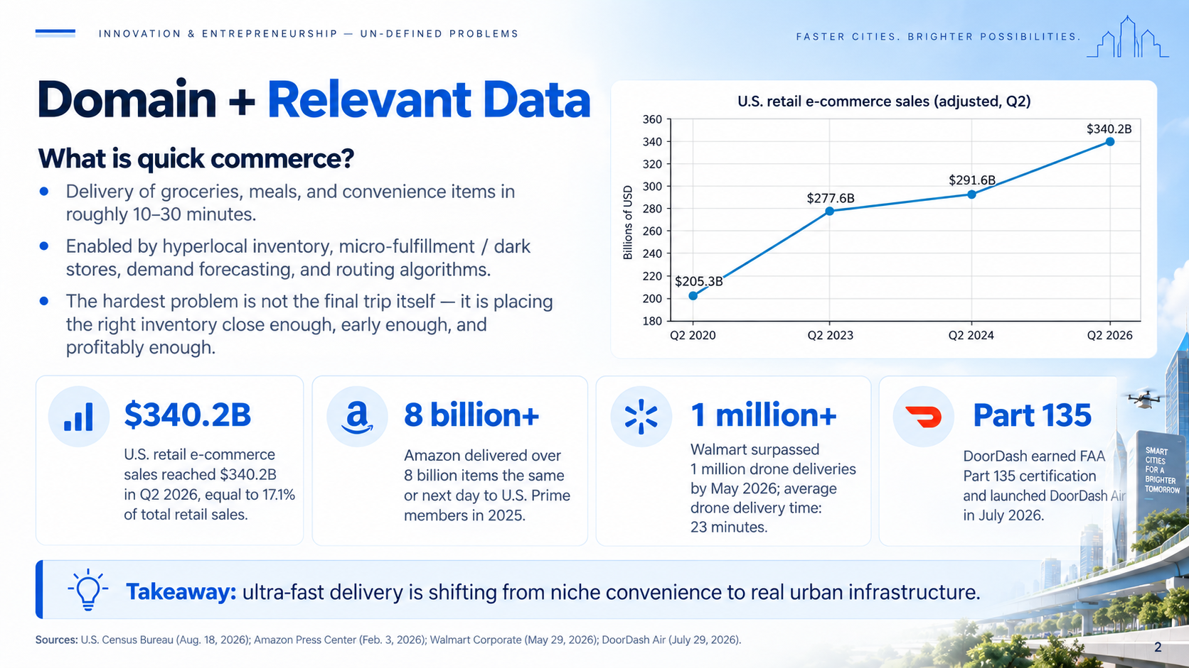
Notes:
Slide 2: Domain + Relevant Data
Intro to domain:
- Quick commerce is the delivery of groceries, meals and convenience items in roughly 10-30 minutes.
- it is already a real and growing domain, not just a thought experiment.
- infrastructure and tools for quick commerce are hyperlocal inventory, micro-fulfillment, and demand forecasting and routing algorithms.
- the hardest problem for quick commerce is not the delivery, but the system: having the best inventory placement, forecasting, and routing
How to read the chart:
- The chart shows U.S. retail e-commerce sales (adjusted, Q2) rising from about $205.3B in Q2 2020 to $340.2B in Q2 2026.
- This does not mean every dollar is quick-commerce spending; it shows the broader digital-commerce environment that supports demand for faster fulfillment. (the process of delivering a customer’s order)
- The main takeaway is that digital purchasing behavior is large, stable, and still growing.
Why the metric cards matter:
- Census: retail e-commerce sales are $340.2B in Q2 2026, which is 17.1% of total retail sales. This shows the size of the online market.
- Amazon: over 8 billion same- or next-day items in the U.S. in 2025 shows that very fast fulfillment is becoming normalized at scale.
- Walmart: 1 million+ drone deliveries and a 23-minute average delivery time show that autonomous delivery is moving beyond pilots.
- DoorDash: got an FAA Part 135 certification for DoorDash Air (drone delivery). This shows regulatory progress, not just technical possibility.
Interpretation:
- Together, these data points suggest that ultra-fast delivery is evolving from a premium feature into a serious layer of urban infrastructure.
- That is exactly the kind of trend that can be pushed "to the absurd" for opportunity discovery.
Suggested transition:
- If these signals continue, what would the world look like when almost anything physical can reach you in 10 minutes?

Slide 3
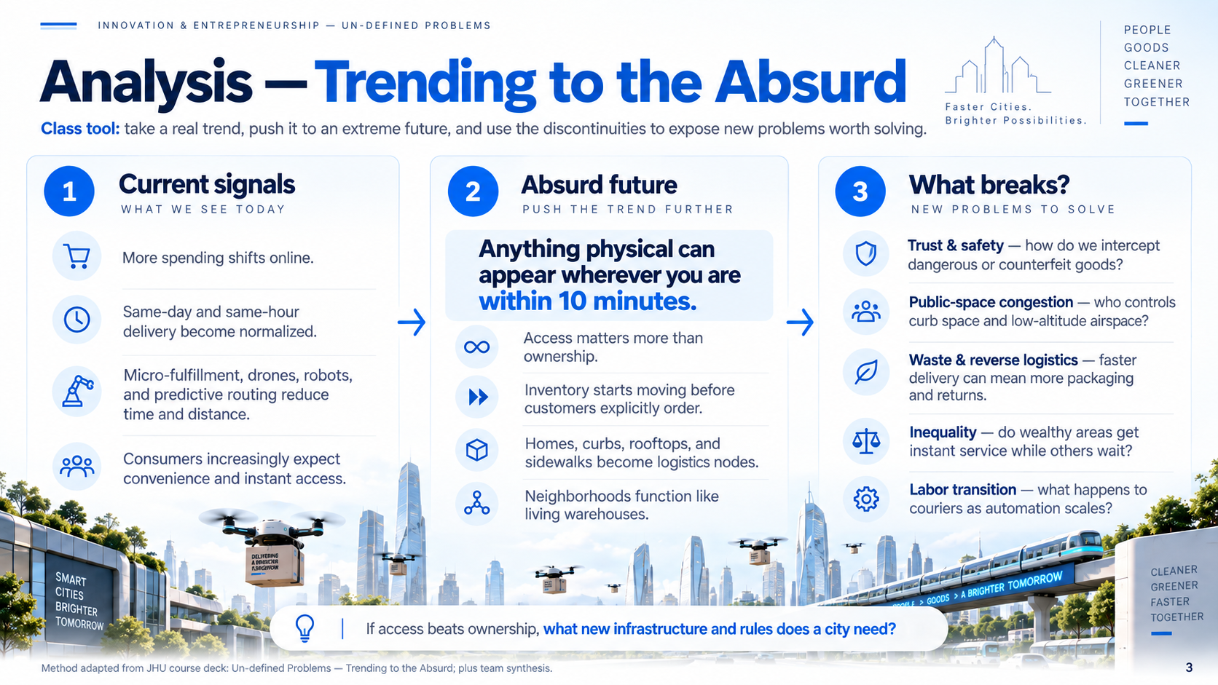
Notes:
Slide 3: Analysis — Trending to the Absurd
What method we are using:
- "Trending to the Absurd" starts with a real trend, extends it far beyond today, and uses the discontinuities to expose hidden assumptions and new problems.
- The point is not to predict exactly what will happen; the point is to generate a more interesting opportunity space.
Current signals:
- Online spending continues to grow.
- Consumers are increasingly trained to expect convenience, immediacy, and low friction.
- Micro-fulfillment (small-scale local warehouse), robotics, drones, and prediction systems all reduce response time.
- These signals justify taking the trend seriously.
What the absurd future means:
- The central future statement is: anything physical can appear wherever you are within 10 minutes.
- In this world, ownership may matter less than access.
- Goods may begin moving before explicit orders are placed, because the system predicts demand.
- Homes, curbs, rooftops, and sidewalks become part of the logistics network.
- The neighborhood starts functioning like a distributed warehouse (spread inventory across different locations).
Why the "what breaks?" column matters:
- Trust and safety: faster movement and delivery speed makes screening harder.
- Public-space congestion: airspace and curb space become contested resources.
- Waste and reverse logistics: convenience creates more packaging unless reverse flows improve.
- Inequality: premium infrastructure may concentrate in wealthy areas.
- Labor transition: some human delivery jobs may change or disappear.
Main insight:
- The interesting opportunities are not only about moving packages faster.
- They are about the new governance, infrastructure, and service layers required by this future.

Slide 4
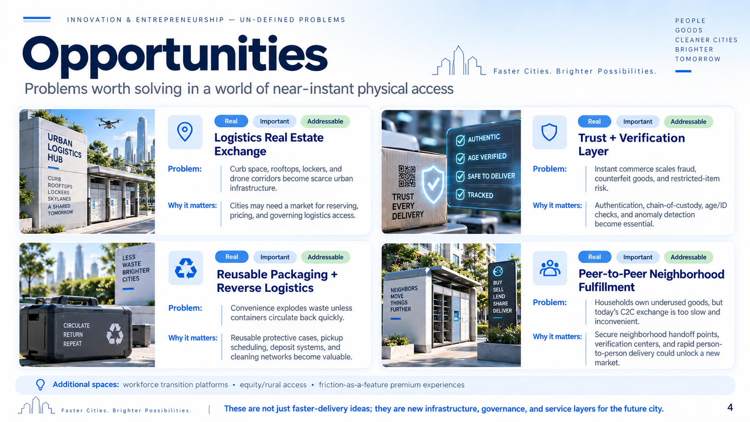
Notes:
Slide 4: Opportunities
What this slide is doing:
- This is not a list of final products.
- It identifies problem spaces that become important if near-instant physical access becomes normal.
- Each opportunity is framed to satisfy the course logic: real, important, and at least somewhat addressable.
Opportunity 1 — Logistics Real Estate Exchange:
- If drones, lockers, and instant drop-offs become common, curb space, rooftops, skylanes, and access points become scarce urban assets.
- A city may need systems for reserving, pricing, and governing these spaces.
- This turns physical access into a new kind of market infrastructure.
Opportunity 2 — Trust + Verification Layer:
- The faster goods move, the less time there is for human checking.
- That creates demand for authentication, chain-of-custody tracking (in delivery process, record each point of transfer for a product), age verification, and fraud detection.
- Trust becomes a bottleneck for scaling up rapid delivery systems.
Opportunity 3 — Reusable Packaging + Reverse Logistics:
- Ultra-fast delivery can dramatically increase packaging waste.
- Reusable containers, deposit systems, pickup scheduling, and cleaning networks become valuable support layers.
- Convenience without circularity is environmentally expensive.
Opportunity 4 — Peer-to-Peer Neighborhood Fulfillment:
- If access matters more than ownership, neighborhoods may become local exchange networks.
- Secure handoff points and person-to-person delivery could make underused household items much easier to share, lend, or rent.
- This could shift some fulfillment from B2C (biz to consumer) toward C2C (consumer to consumer) or community-level infrastructure.
Closing interpretation:
- The best opportunities here are not just faster-delivery businesses.
- They are enabling layers for the future city: governance, trust, circular logistics, and new exchange systems.

